Slide 1
Control Structures

Slide 2
INDEX
Introduction
if Selection Structure
if/else and if/elif/else Selection Structures
while Repetition Structure
Sample programs
Nested loops
for repetition operator
break and continue
Loop with Else

Slide 3
INTRODUCTION
Sequential order
  Statements are executed in the order they are written
Transfer of control
  A program executes a statement which is placed somewhere else using control structures
  The control structure statements
    Allows a program to go to a wide range of areas in the code
    Structured programming was broken with the use of any control structures statements.
3 control structures
  Sequential structure
    Built into Python
  Selection structure
    The if statement, if/else statement and if/elif/else statement
  Repetition structure
    The while repetition structure
    The for repetition structure

Slide 4
IF SELECTION STRUCTURE
The if statement
  It is a single entry, single exit structure.
  Allows a program to perform an action only if a statement is true.
  Otherwise the action is skipped.
true
Grade >= 60
print “Passed”
false

Slide 5
IF-ELSE AND IF-ELIF-ELSE STRUCTURES
The if/else statement
  Double selection statement
  Allows the programmer to perform an action when a condition is true.
  An alternate action is preformed when the action is false.
The if/elif/else statement
  Multiple selection statement
  This is used in place of nested if/else statements.
  The final else statement is optional, it is used as a default action should all other statements be false.

Slide 6
IF-ELSE AND IF-ELIF-ELSE STRUCTURES
if
false
true
Grade >= 60
print “Failed”
print “Passed”
if/else double-selection structure flowchart.

Slide 7
IF-ELSE AND IF-ELIF-ELSE STRUCTURES
if statement
condition a
true
case a action(s)
false
first elif statement
true
condition b
case b action(s)
false
.
.
.
last elif statement
true
condition z
case z action(s)
false
else statement
default action(s)
if/elif/else multiple-selection structure.

Slide 8
SAMPLE IF STATEMENT
Python 2.2b2 (#26, Nov 16 2001, 11:44:11) [MSC 32 bit (Intel)] on win32
Type "help", "copyright", "credits" or "license" for more information.
>>> if 1 < 2:
... pass
...
Python 2.2b2 (#26, Nov 16 2001, 11:44:11) [MSC 32 bit (Intel)] on win32
Type "help", "copyright", "credits" or "license" for more information.
>>> if marks > 80:
... print “Passed in First class with distinction”
... elif marks > 60:
... print “Passed in First class”
... elif marks > 40:
... print “Passed in Second class
... else:
... print “Sorry!”

Slide 9
WHILE REPETITION STRUCTURE
Repetition Structures
  Allow a program to repeat an action while a statement is true
Using while Repetition
  The action is contained within the body of the loop
    Can be one or more than one action
  Condition should evaluate to false at some point
    Creates a infinite loop and program hangs

Slide 10
WHILE REPETITION STRUCTURE
while
true
Product <= 1000
Product = 2 * product
false

Slide 11
SAMPLE PROGRAMS
Counter controlled repetition
  Called definite repetition (The number of loops is known before the loop starts).
  Uses a counter to limit the number of times a loop repeats
  Counter must be incremented or decremented in the loop
  Pseduo Code
  Set total to zero
  Set grade counter to one
  While grade counter is less than or equal to ten
  Input the next grade
  Add the grade into the total
  Add one to the grade counter
  Set the class average to the total divided by ten
  Print the class average

Slide 12
SAMPLE PROGRAMS
1 # Fig. 3.10: fig03_10.py
2 # Class average program with counter-controlled repetition.
3
4 # initialization phase
5 total = 0 # sum of grades
6 gradeCounter = 1 # number of grades entered
7
8 # processing phase
9 while gradeCounter <= 10: # loop 10 times
10 grade = raw_input( "Enter grade: " ) # get one grade
11 grade = int( grade ) # convert string to an integer
12 total = total + grade
13 gradeCounter = gradeCounter + 1
14
15 # termination phase
16 average = total / 10 # integer division
17 print "Class average is", average
The total and counter, set to zero and one respectively
A loop the continues as long as the counter does not go past 10
Adds one to the counter to eventually break the loop
Divides the total by the 10 to get the class average

Slide 13
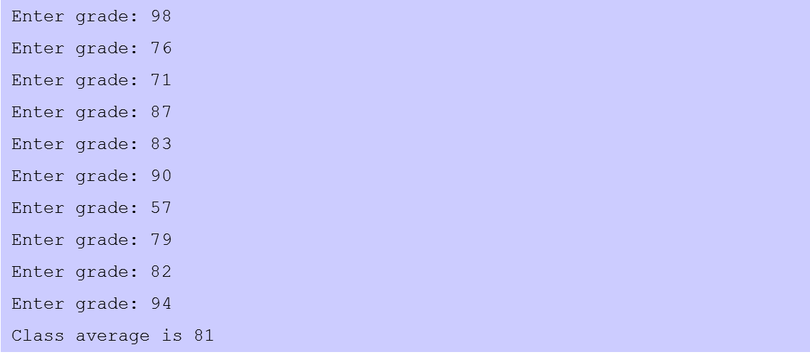
SAMPLE PROGRAMS

Slide 14
NESTED LOOPS
Nesting
  Inserting one control structure into another
    A loop inside of a loop
    An if statement inside an another if statement.
    An if statement inside an loop.

Slide 15
SAMPLE PROGRAMS
1 # Sample program for nested loops
2 # Analysis of examination results.
3
4 # initialize variables
5 passes = 0 # number of passes
6 failures = 0 # number of failures
7 studentCounter = 1 # student counter
8
9 # process 10 students; counter-controlled loop
10 while studentCounter <= 10:
11 result = raw_input( "Enter result (1=pass,2=fail): " )
12 result = int( result ) # one exam result
13
14 if result == 1:
15 passes = passes + 1
16 else:
17 failures = failures + 1
18
19 studentCounter = studentCounter + 1
20
21 # termination phase
22 print "Passed", passes
23 print "Failed", failures
24
25 if passes > 8:
26 print "Raise tuition"
This if/else statement is nested within the while loop

Slide 16
SAMPLE PROGRAMS
Enter result (1=pass,2=fail): 1
Enter result (1=pass,2=fail): 1
Enter result (1=pass,2=fail): 1
Enter result (1=pass,2=fail): 1
Enter result (1=pass,2=fail): 2
Enter result (1=pass,2=fail): 1
Enter result (1=pass,2=fail): 1
Enter result (1=pass,2=fail): 1
Enter result (1=pass,2=fail): 1
Enter result (1=pass,2=fail): 1
Passed 9
Failed 1
Raise tuition

Slide 17
FOR REPETITION OPERATOR
The for loop
  The loop will be executed as many times the value passed
  Example: for counter in range ( value )
Techniques
  If the third value passed is negative then the loop will count backwards through the provided numbers
  Avoid putting useless need code in a loop
    If possible evaluate beforehand

Slide 18
FOR REPETITION OPERATOR
Establish initial value of control variable
x = first item in y
Determine if final value of control variable has been processed
true
x = next item in y
more items to process
print x
Body of loop (this may be many statements)
false
Update the control variable (Python does this automatically)

Slide 19
SAMPLE PROGRAMS
1 # Fig. 3.18: fig03_18.py
2 # Counter-controlled repetition with the
3 # for structure and range function.
4
5 for counter in range( 10 ):
6 print counter
Makes the counter go from zero to nine
0
1
2
3
4
5
6
7
8
9

Slide 20
RANGE FUNCTIONS
  Function range is used to create a list of values
      range ( integer )
        Values go from 0 u to given integer
      range ( integer, integer )
        Values go from first up to second integer
      range ( integer, integer, integer )
        Values go from first up to second integer but increases in intervals of the third integer
  The loop will execute as many times

Slide 21
SAMPLE PROGRAMS
1 # Fig. 3.22: fig03_22.py
2 # Summation with for.
3
4 sum = 0
5
6 for number in range( 2, 101, 2 ):
7 sum += number
8
9 print "Sum is", sum
Loops from 2 to 101 in increments of 2
A sum of all the even numbers from 2 to 100
Sum is 2550

Slide 22
BREAK AND CONTINUE
The break statement
  Used to make a loop stop looping
  The loop is exited and no more loop code is executed
The continue statement
  Used to continue the looping process
  All following actions in the loop are not executed
    But the loop will continue to run

Slide 23
SAMPLE PROGRAMS
1 # Fig. 3.24: fig03_24.py
2 # Using the break statement in a for structure.
3
4 for x in range( 1, 11 ):
5
6 if x == 5:
7 break
8
9 print x,
10
11 print "\nBroke out of loop at x =", x
The loop will go from 1 to 10
When x equals 5 the loop breaks. Only up to 4 will be displayed
Shows that the counter does not get to 10 like it normally would have
1 2 3 4
Broke out of loop at x = 5

Slide 24
SAMPLE PROGRAMS
1 # Fig. 3.26: fig03_26.py
2 # Using the continue statement in a for/in structure.
3
4 for x in range( 1, 11 ):
5
6 if x == 5:
7 continue
8
9 print x,
10
11 print "\nUsed continue to skip printing the value 5"
The loop will continue if the value equals 5
The value 5 will never be output but all the others will
1 2 3 4 6 7 8 9 10
Used continue to skip printing the value 5

Slide 25
LOOP WITH ELSE
When else used with loops, else clause will run when NO break occurs.
# Sample program for nested loops
# finding a prime number from 1 – 10
3 for n in range(2,10):
for I in range(2,n):
if n % x == 0:
print “%s equals %x\n” % (n,x)
break
else:
print n,”is a prime number”
Else is used with for loop, NOT with if.

